Slide 1
MATERIALS inspection
Reference Text Section
TEXTBOOKS:
Higgins RA & Bolton, 2010. Materials for Engineers and Technicians , 4th edition, Butterworth Heinemann Ch 3
Sheedy, P. A, 1994. Materials : their properties, testing and selection
Byrnes, J. J, 1983. Testing and treatment of materials

Slide 2
MATERIALS TESTING
Why are metals tested ?
Ensure quality
Test properties
Prevent failure in use
Make informed choices in using materials
Factor of Safety is the ratio comparing the actual stress on a material and the safe useable stress.
Factor of Safety describes the structural capacity of a system beyond the expected loads or actual loads (The safety factor is how much the designed part actually will be able to withstand )

Slide 3
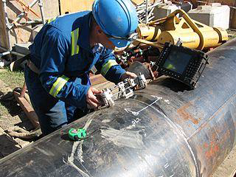
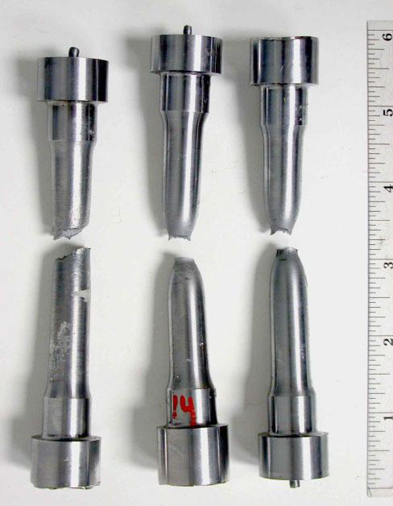
Two forms of tests
Destructive tests (DT) is called mechanical tests. It requires destroying the specimen in order to measure the property. Often requires a specially prepared specimen. (e.g. Tensile test).
Non-destructive tests (NDT): measures attributes of the specimen without damaging it. Does not normally need a prepared specimen. Typically used to find flaws inside a part.
(e.g. X-ray, Ultrasound) .
Tensile Test specimens
Ultrasonic Weld Inspection:

Slide 4
Types of Loading
Tensile
Compressive
Shear
Torsion
Bending
Notes:
Torsional forces (T) produce a rotational motion about the longitudinal axis of one end of the member relative to the other

Slide 5
Types of stresses
Compressive stress is the stress applied to materials resulting in their compaction (decrease of length). Usually compressive stress is applied to bars, columns, etc.
Tensile stress is the stress state leading to expansion (length of a material tends to increase). In the uniaxial manner of tension, tensile stress is induced by pulling forces across a bar, specimen, etc.
Shear stress: is a force that causes layers or parts to slide upon each other in opposite directions.
Torsion the stress which resists a force tending to twist the material (e.g. axle, screw, etc.)
Bending stress occurs when the force applied tends to pull a horizontal bar out of its straight line.

Slide 6
Destructive tests (DT)
Tensile testing
Compression testing
Torsion testing
Hardness testing
Bending testing
Impact testing
Creep testing
Fatigue testing
Other mechanical tests

Slide 7
Why use NDT?
Components are not destroyed
Can test for internal flaws
Useful for valuable components
Can test components that are in use

Slide 8
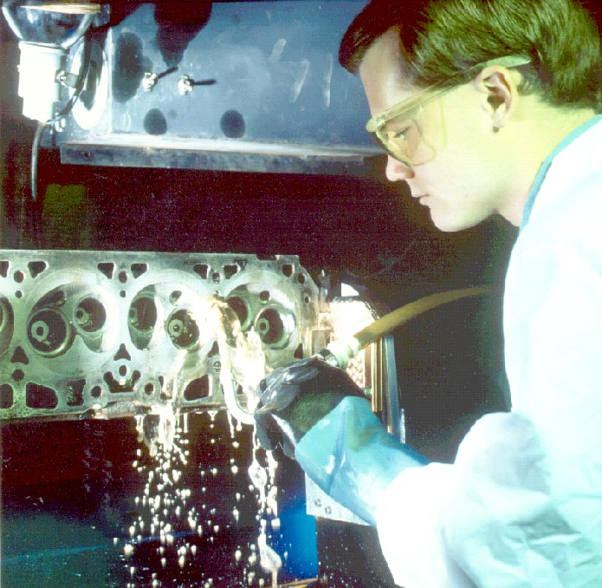
Six Most Common NDT Methods
Visual Testing
Liquid Penetrant Testing
Magnetic Particle Testing
Eddy Current
Ultrasonic Testing
Radiography Testing (X-ray Inspection)

Slide 9
Material properties
Physical properties
Mechanical properties
Chemical properties
Physical properties
colour –light wave length
specific heat – the heat required to raise the temperature of one gram of a substance by one degree centigrade (J/kg K)
density – mass per unit volume expressed in such units as kg/cm ³
thermal conductivity –rate at which heat flows through a given material (W/m K)
melting point – a temperature at which a solid begins to liquify
electrical conductivity – a measure of how strongly a material opposes the flow of electric current (Ω⋅m)
coefficient of thermal expansion – degree of expansion divided by the change in temperature (m/°C)

Slide 10
Mechanical properties
Tensile strength – measures the force required to pull something such as rope,wire or a structural beam to the point where it breaks
Malleability – the property of a material that can be worked or hammered or shaped without breaking
Ductility--ability to deform under tensile load without rupture; high percentage elongation and percent reduction of area indicate ductility brittleness –breaking or shattering of a material when subjected to stress (when force is applied to it)
Elasticity – the property of a material that returns to its original shape after stress (e.g. external forces) that made it deform or distort is removed
Plasticity - the deformation of a material undergoing non-reversible changes of shape in response to applied forces

Slide 11
Stiffness(Rigidity)--ability to resist deformation; proportional to Young’s Modulus E (psi) E = stress/strain (slope of linear portion of stress/strain curve).
Toughness – the ability of a material to absorb energy and plastically deform without fracturing
Hardness – Hardness is closely related to strength. It is the ability of a material to resist scratching, abrasion, indentation, or penetration.
Brittleness- The brittleness of a material is the property of breaking without much permanent distortion. There are many materials, which break or fail before much deformation take place. Such materials are brittle e.g., glass, cast iron.
Machinability –is the property of a material or a part to be machined, i.e., to remove material by cutting or abrasive processes, under given conditions

Slide 12
Chemical properties
Mechanical properties | Test
Strength | Tensile/ Compression/ Shear
Stiffness | Slope of Stress-vs-Strain curve
Hardness | Rockwell / Brinell / Vickers/ Micro hardness
Toughness | Impact: Charpy / Izod
Corrosion resistance - a material's ability to resist deterioration caused by exposure to an environment
Burning (Flammability): A material’s ability to BURN in the presence of Oxygen

Slide 13
Which properties do the following materials possess?
Material | Properties
Aluminium | Lightness ; Strength
Rubber | Elasticity ; Insulation
Ceramics | Thermal Resistivity
Steel | Strength
Copper | Conductivity ; Corrosion Resistance
Lead | High Density; Ductility
Nylon | Strength ; Toughness
Wood | Insulation ; Environmental Friendliness

Slide 14
Find application for the following engineering materials:
Material | Application
Aluminium | Foil; Aircraft; Window Frame
Rubber | Tyres,; Seal; Gasket
Ceramics | Furnace; Brick
Steel | Section; Pipe
Copper | Pipe; Cables
Lead | Storage Battery; Radiation Protection Bullets
Nylon | Rope; Clothing
Cast Iron | Engine Block; Valves
Wood | Furniture; Deck

